Slide 1
Naval Information Warfare Systems Command
(NAVWAR)
Navy Civilian Acculturation Program
2021
Mission Statement
The Department of the Navy will recruit, train, equip, and organize to deliver combat ready naval forces to win conflicts and wars while maintaining security and deterrence through sustained forward presence.

Slide 2
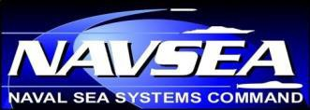
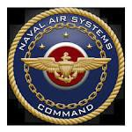
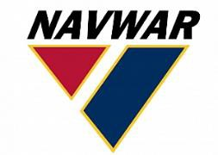


Systems Commanders (SYSCOMS)
Systems Commanders (SYSCOMs) oversee technical requirements of the Navy and report to the CNO and SECNAV
SYSCOMs provide, support, modernize, and maintain major systems, but are not in the administrative or operational chain of command of the Navy’s operating forces
Navy Systems Commands include:
  Naval Sea Systems Command (NAVSEA)
  Naval Air Systems Command (NAVAIR)
  Naval Information Warfare Systems Command (NAVWAR)
  Naval Supply Systems Command (NAVSUP)
  Naval Facilities Engineering Command (NAVFAC)

Slide 3
Type Commander (TYCOM)
Type Commander
Type Commanders (TYCOMs) are administratively responsible for force readiness (i.e., manning, maintenance, training, equipping, etc.)
The Pacific and Atlantic Fleets have forces classified and organized into commands related directly to their type
Capital Ships, Submarine Groups, Destroyer Squadrons, Amphibious Squadrons, Aviation Type Wings, Expeditionary Groups, Information Centers and Groups
Individual Ships, Submarines, Aviation Squadrons, Expeditionary Forces, and Information Forces

Slide 4


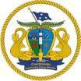

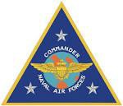
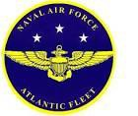
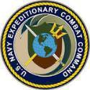

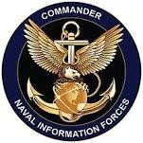
Type Commands
Type Commands:
  Naval Surface Force, U.S. Pacific Fleet (COMNAVSURFPAC)
  Naval Surface Force, U.S. Atlantic Fleet (COMNAVSURFLANT)
  Submarine Force, U.S. Atlantic Fleet (COMSUBLANT)
  Submarine Force, U.S. Pacific Fleet (COMSUBPAC)
  Naval Air Force, U.S. Pacific Fleet (COMNAVAIRPAC)
  Naval Air Force, U.S. Atlantic Fleet (COMNAVAIRLANT)
  Naval Expeditionary Combat Command (COMNECC)
  Military Sealift Command (MSC)
  Naval Information Forces (COMNAVIFOR)

Slide 5
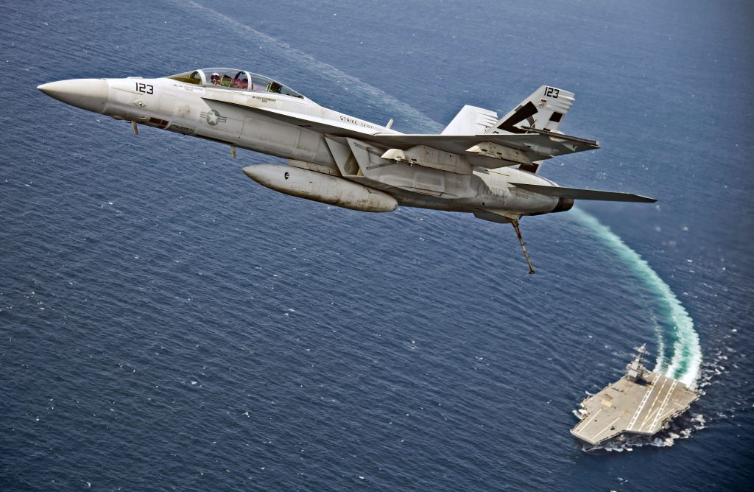
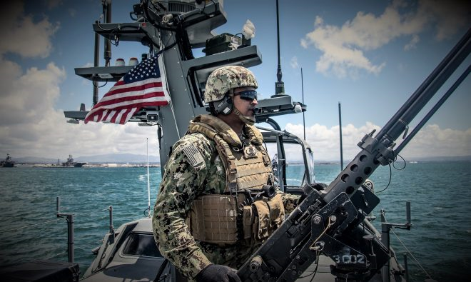
Overview of the Navy’s Major Warfare Communities
Aviation: Employs deployable, combat-ready Naval Aviation forces to project military air power.
  Fleet air defense
  Strategic projection
  Anti-submarine warfare
  Anti-surface warfare
Expeditionary: Encompasses a wide array of combat, combat support, and combat service support missions around the globe.
  Maritime security and force protection
  Explosive ordnance disposal (EOD);
  Diving and salvage
  Expeditionary logistics
  Mobilization support
  Expeditionary intelligence

Slide 6
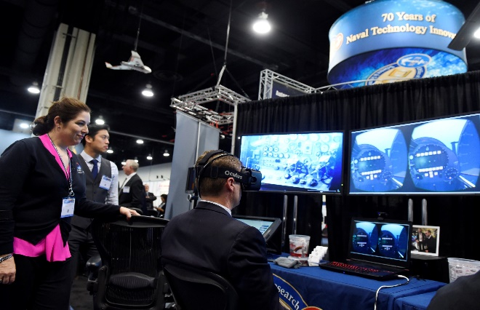

Overview of the Navy’s Major Warfare Communities (Con’t)
Information: Generates, directly and through the Information Warfare (IW) enterprise.
  Networks
  Electronic warfare
  Intelligence
  Oceanography
  Cyberspace operations
Naval Special Warfare: Mans, trains, equips, educates deploys, resources and sustains Naval special operations forces.
  Multi-purpose combat forces organized to conduct a variety of special operations in all environments
  Special Boat Teams
  Mission Enablers

Slide 7
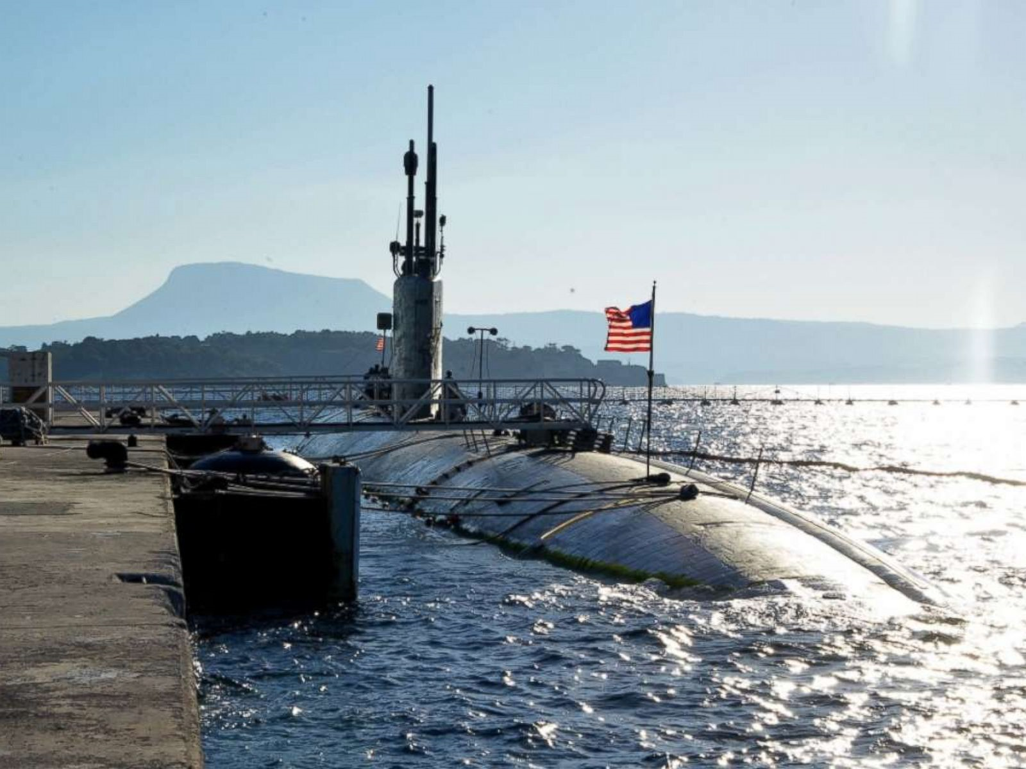
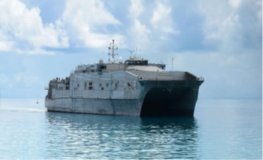
Overview of the Navy’s Major Warfare Communities (Con’t)
Submarine: Executes the mission of the U.S. Navy in and from the undersea domain.
  Strategic deterrent patrols
  Special operations support
  Intelligence collection
  Communications
  Non-provocative transits
  Surface and undersea battlespace control
Surface: Backbone of the America’s Navy comprised of a surface force that conducts a variety of missions across 9 different ship classes.
  Anti-air warfare
  Amphibious warfare
  Ballistic missile defense
  Visit, Board, Search, and Seizure (VBSS)
  Mine warfare
  Anti-submarine warfare

Slide 8
Overview of Current Naval Platforms and Weapons Systems
The following provides a basic snapshot of the Navy’s warfighting platforms.
Aircraft
Fixed Wing
C-2A Greyhound Logistics Aircraft
E-2D Hawkeye Early Warning and Control Aircraft
EA-18G Growler Airborne Electronic Attack Aircraft
F/A-18E/F Super Hornet Strike Fighter
F-35C- Lighting II
Rotary Wing
MH-60R/S Seahawk
MV-22 Osprey Tilt Rotor Aircraft
To learn more about other aircraft and the missions they are
employed in please visit the Fact Files section of Navy.mil: https://www.navy.mil/navydata/fact.asp

Slide 9
Overview of Current Naval Platforms and Weapons Systems (Con’t)
Military Sealift Ships
Underway Replenishment Oilers (T-AO)
Dry Cargo/Ammunition Ships (T-AKE)
Fast Combat Support Ships (T-AOE)
To learn more about other Military Sealift Command (MSC) ships and how they
are employed, please visit the MSC website: https://sealiftcommand.com/about-msc/ships-msc
Submarines and Associated Hull Designations
Attack Submarine (SSN)
Fleet Ballistic Missile Submarine (SSBN)
Guided Missile Submarine (SSGN)
Undersea Rescue Command (URC) Assets
Large Scale Vehicles (LSV-2)
To learn more about submarines and the missions they are
employed; please visit the Fact Files section of Navy.mil: https://www.navy.mil/navydata/fact.asp

Slide 10
Overview of Current Naval Platforms and Weapons Systems (Con’t)
Surface Ships and Associated Hull Designations
• Aircraft Carrier (CVN)
• Guided Missile Cruiser (CG)
• Guided Missile Destroyer (DDG-1000 and DDG-51)
• Amphibious Assault Ships (LHD, LHA)
• Littoral Combat Ships (LCS-1 and LCS-2)
• Amphibious Dock Landing Ship (LSD)
Ohio-class Fleet Ballistic Missile Submarine (SSBN)
Amphibious ships are specifically designed and employed to transport, land and support Marine Corps expeditionary forces. To learn more about other ship classes and the missions they are employed in, please visit: https://www.navy.mil/navydata/our_ships.asp

